Slide 1
What happened at COP30?
Niklas Höhne
26 Nov 2025

Slide 2
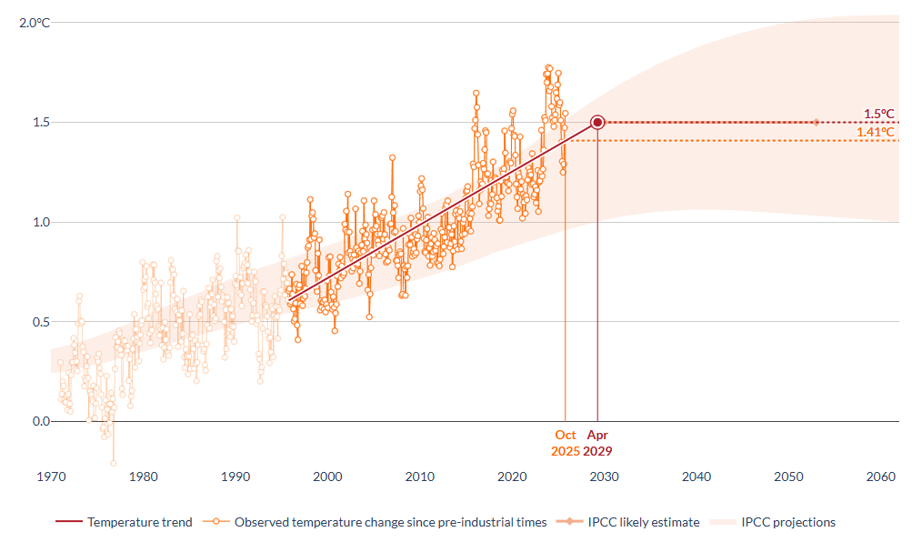
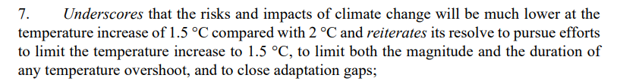
2024 was above 1.5°C
Record temperatures, off scale
Destructive heat, drought, fires
Extreme high ocean temperatures
Extreme weather events, storms, flooding
COP first time acknowledged overshoot of 1.5°C and that it needs to be as short and as low as possible
Source: https://apps.climate.copernicus.eu/global-temperature-trend-monitor/

Slide 3
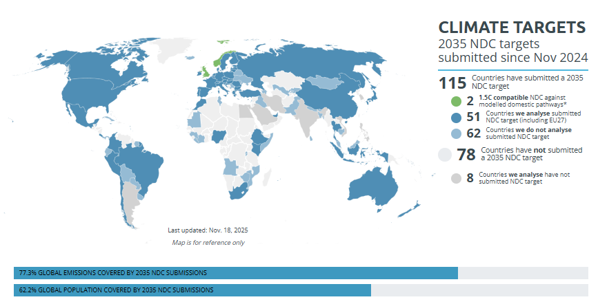
New climate targets do not change the global picture
September less than a third of NDCs, big emitters missing
USA: getting out of Paris, current NDC (from Biden) at odds with current federal developments under Trump
China: submitted 2 weeks before COP, not much difference from current developments
EU: agreed on a 2040 target just before COP. 85% domestic reduction vs originally 90%
India, Saudi Arabia, South Korea, Argentina still missing

Slide 4
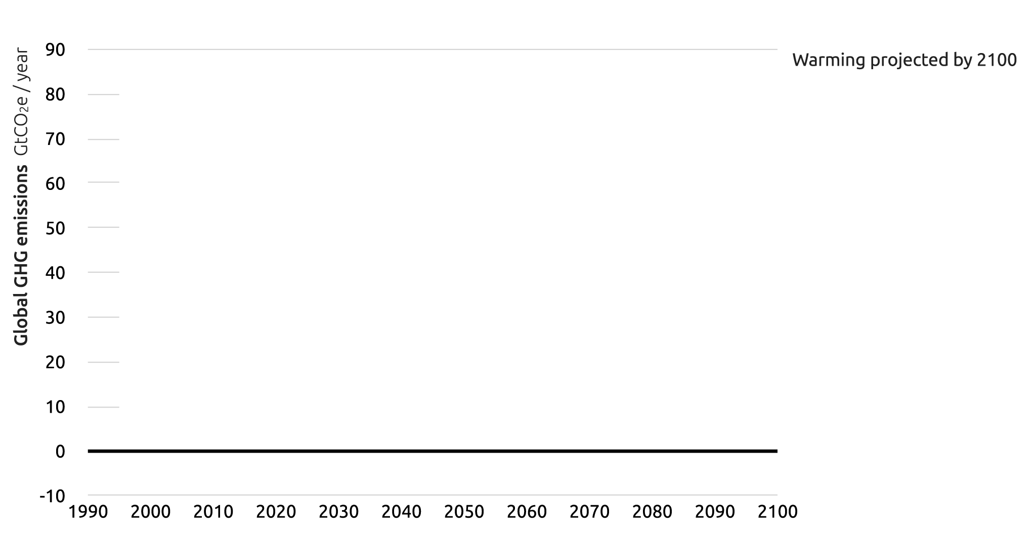











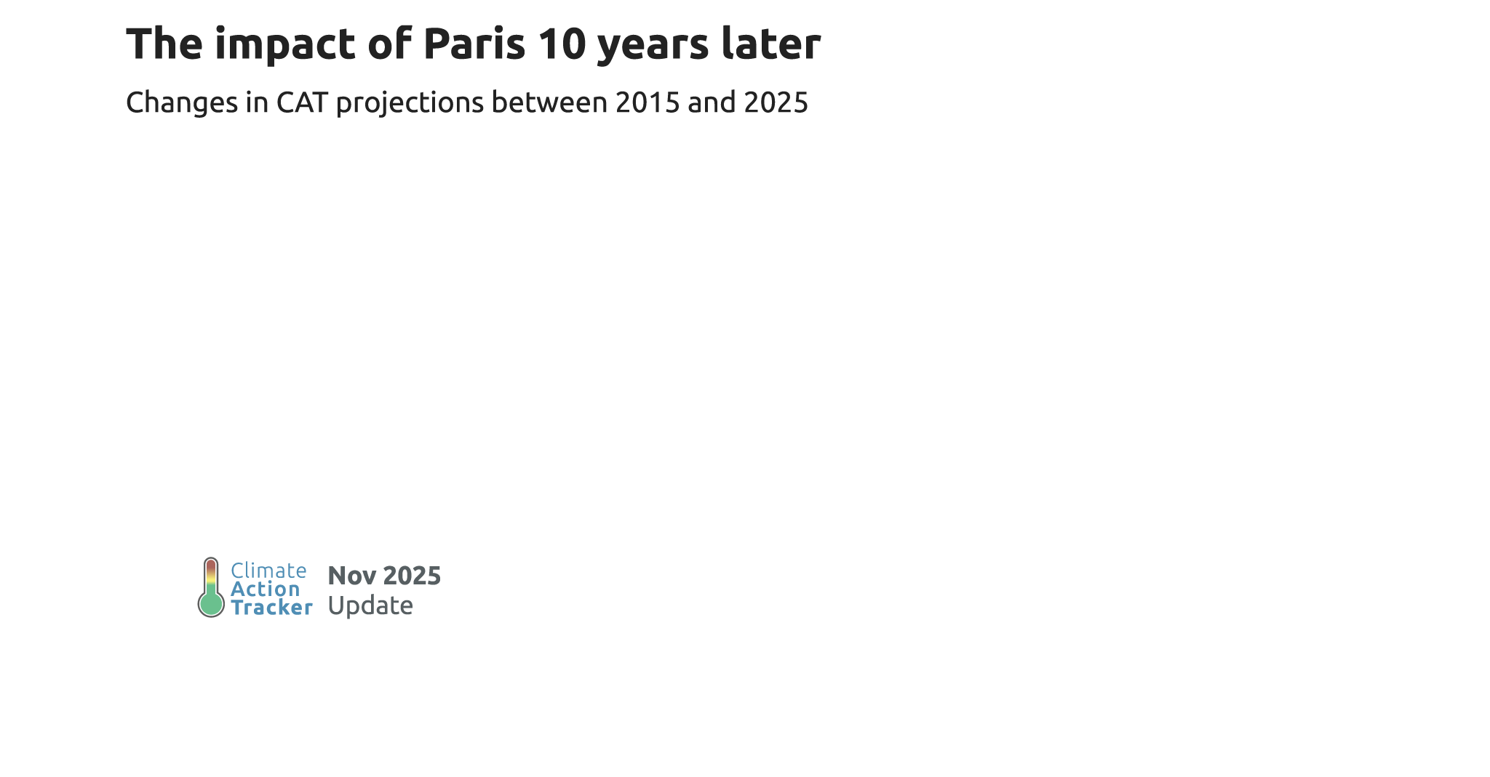


Temperature outlook has improved
www.climateactiontracker.org

Slide 5
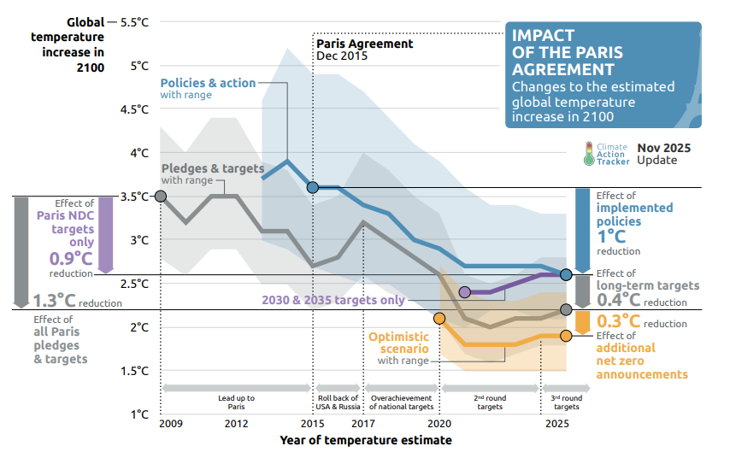
… but not in recent years

Slide 6
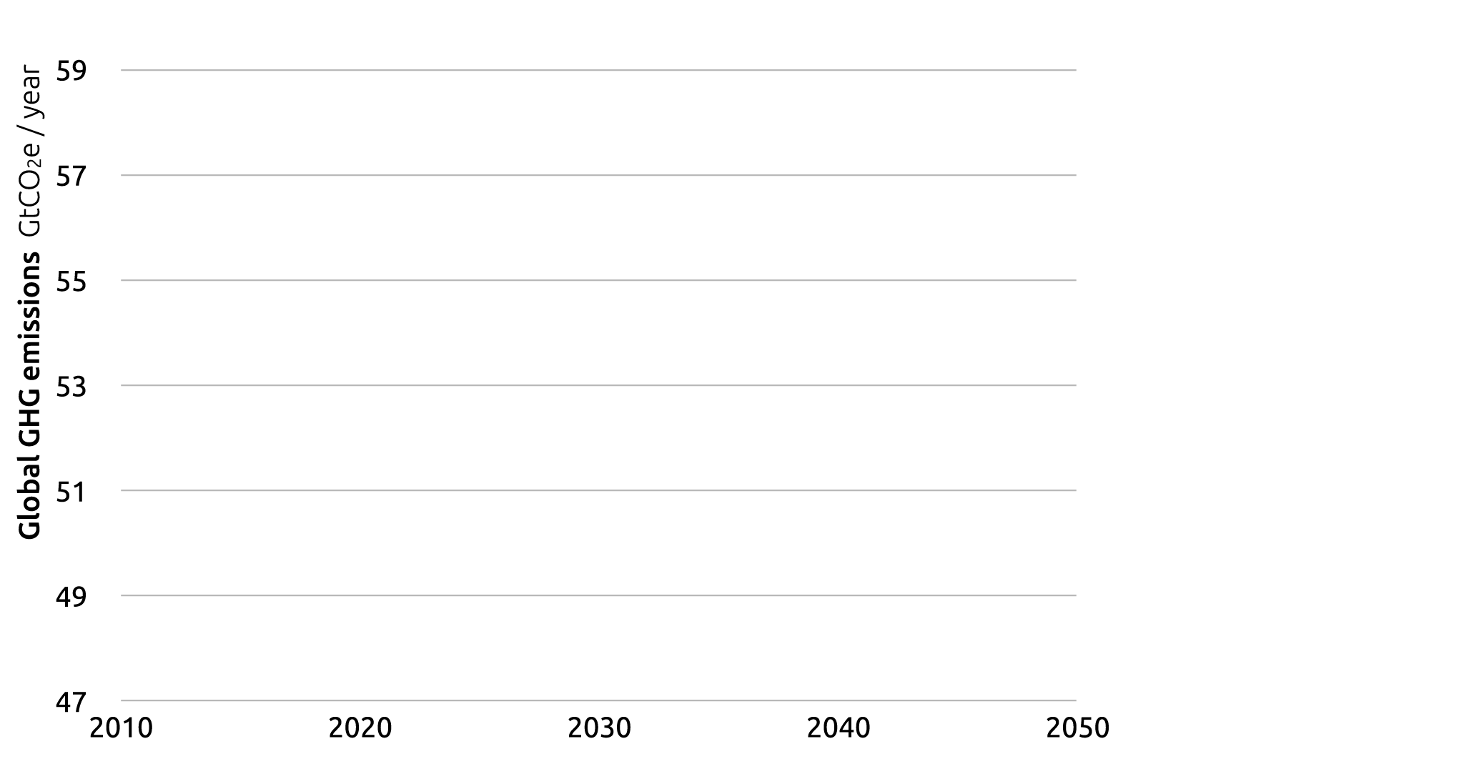
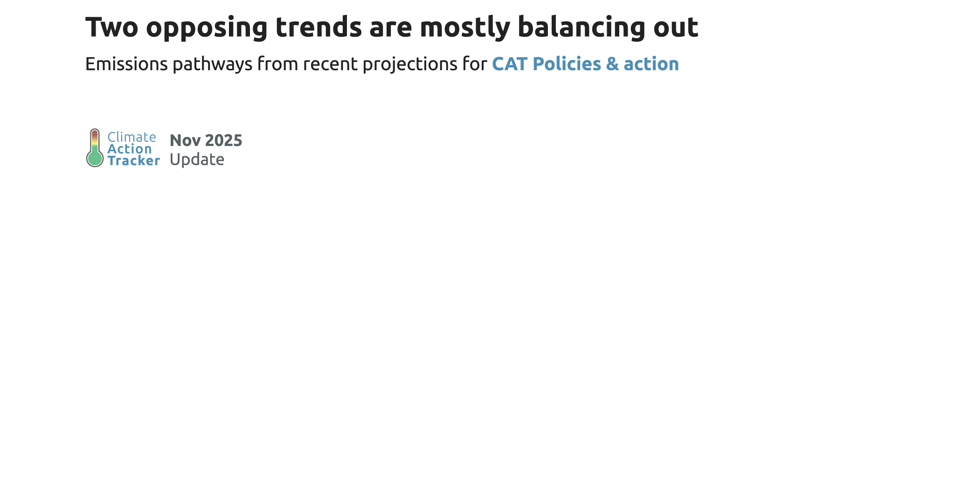



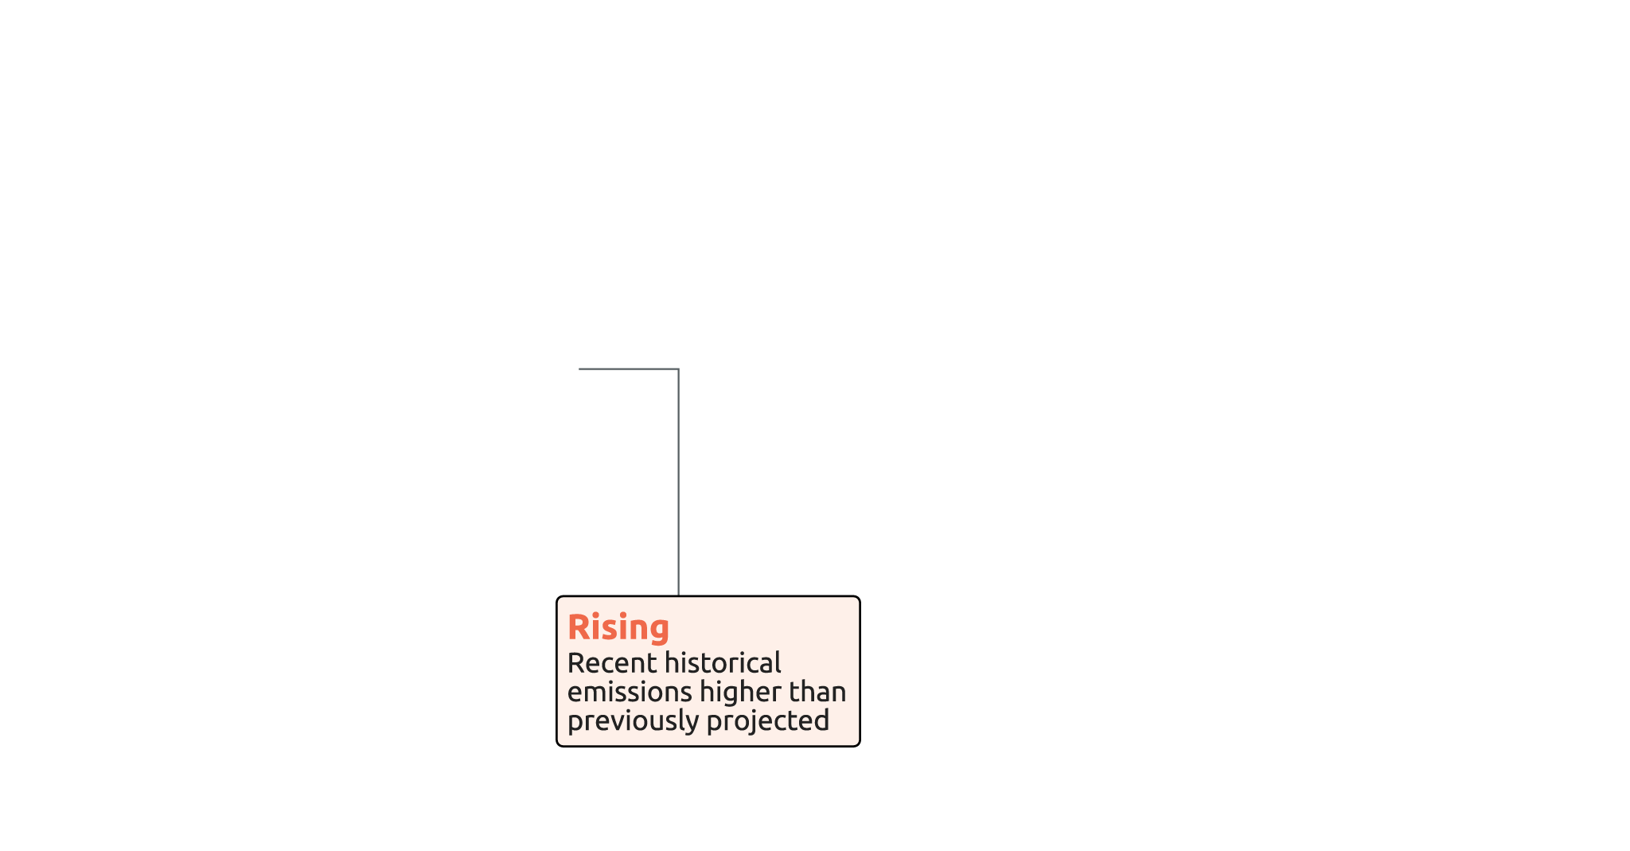

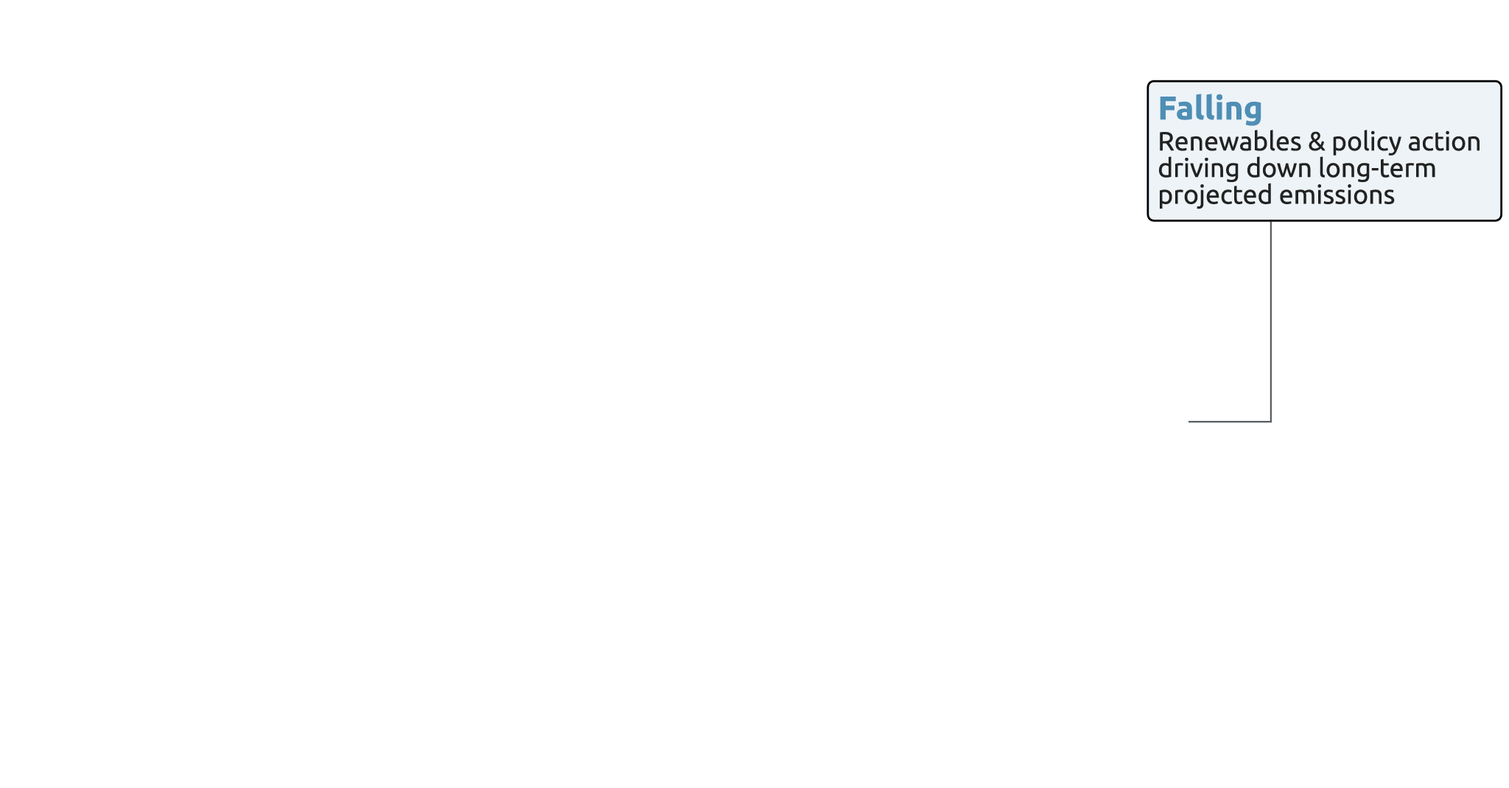
Cancelling trends

Slide 7
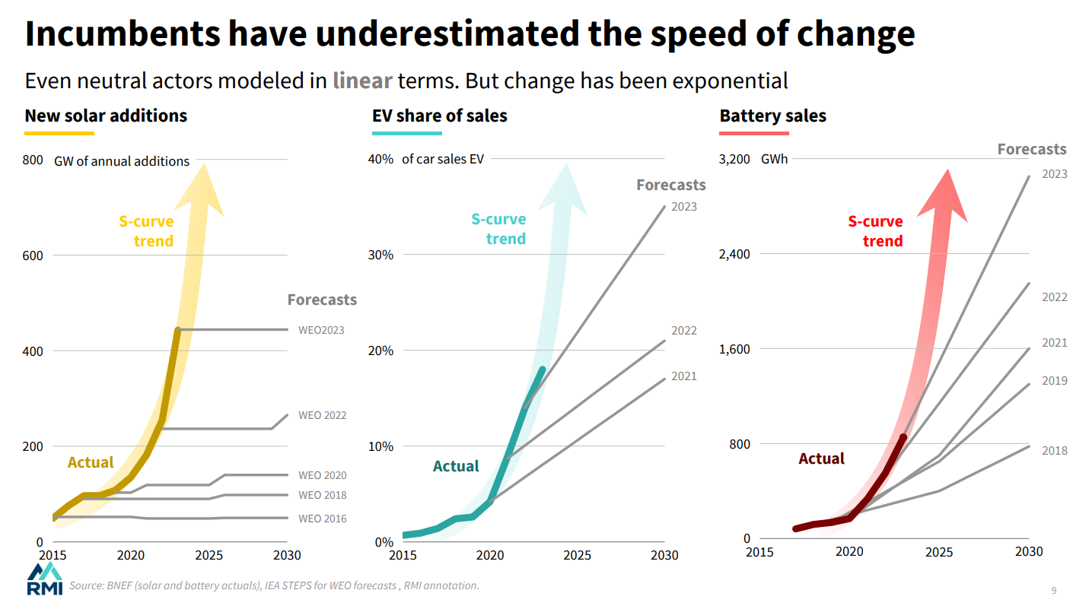

Slide 8
What COP achieved and what is yet to be done
Achieved
Emissions / temperature outlook improved
New national targets for 2035
Much talk about “roadmap for transitioning away from fossil fuels”
Tropical Forest Forever Facility with 7 bln US$
Adaptation
Indicators to measure progress to global goal on adaptation
Triple adaptation finance by 2035
To be done
Emissions are still increasing
Still 1/3 missing
“Fossil fuels” and “roadmap” not in decision
“Roadmap on ending deforestation” not in decision
Minimum expectation achieved (agreement), but altogether not an adequate response to the climate crisis
Further reading: COP30: Key outcomes agreed at the UN climate talks in Belém - Carbon Brief

